Slide 1

Stock Price Prediction
Using News Sentiment and Market Data for Tesla Stock

Slide 2
Steps taken in the Dissertation
Introduction
Data Analysis and Pre-processing
LSTM model
GRU model
Random Forest Regression model
Sentiment analysis model
Hybrid model
Evaluating the model approaches
Literature Review
Data Collection: Market Data and News Data
Conclusions

Slide 3

Introduction
Stock prices are directly linked to a country’s economic health, wealth and stability.
Accurate stock price prediction aids investors in making informed decisions, potentially maximizing returns and minimizing risks.
Accurate stock forecasts help companies time capital raising, R&D investments and expansions

Slide 4

Data collection
Tough to find Reliable source.
NASDAQ official website for historical market data.
Tried to extract news data from websites like Moneycontrol.
Used Alpaca API and got reliable source for news data

Slide 5

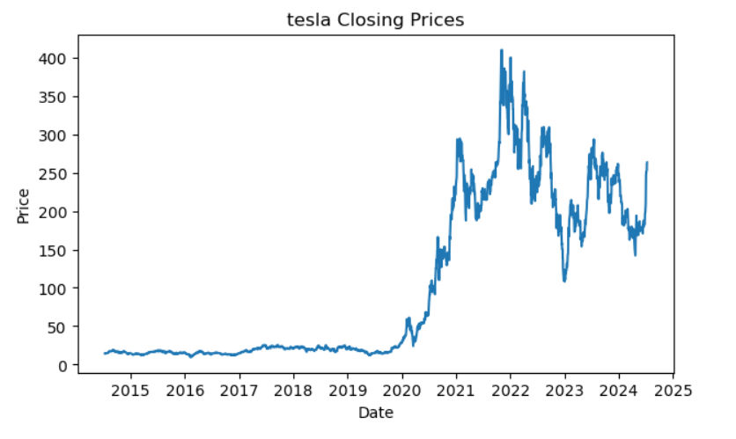
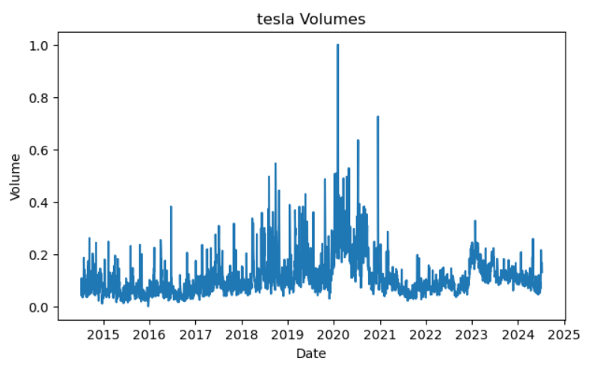
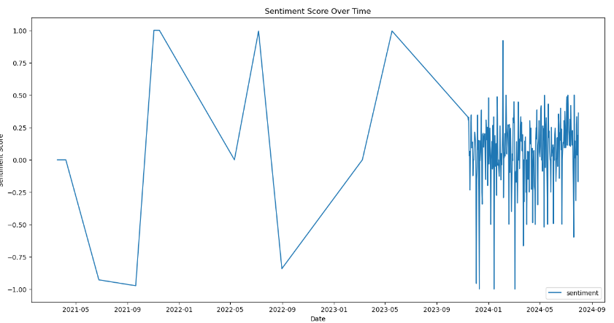
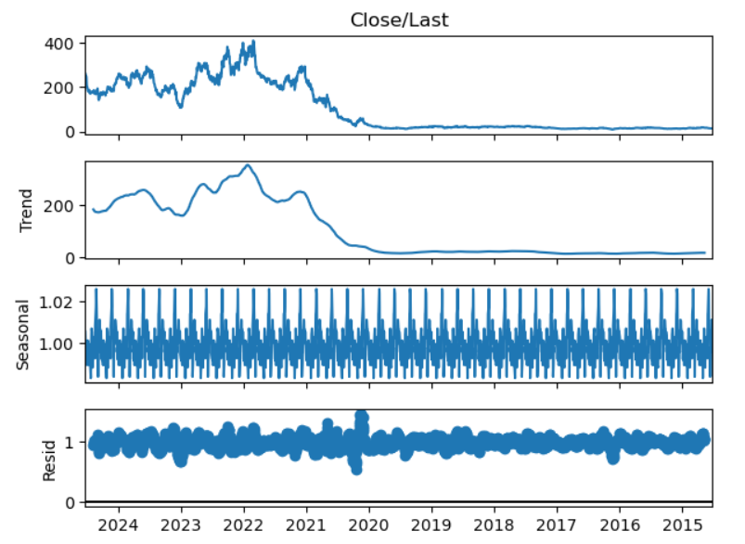
Exploratory Data Analysis

Slide 6
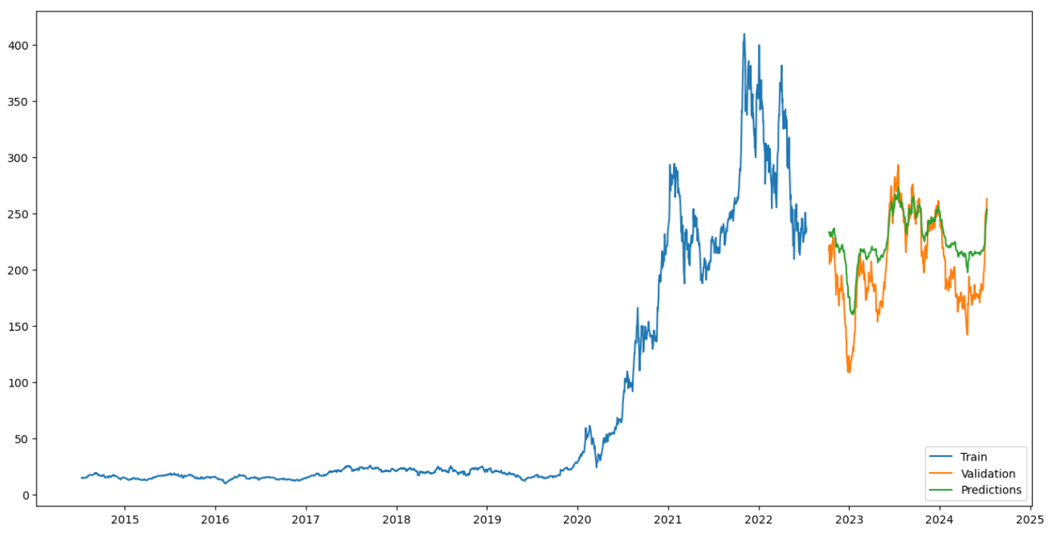
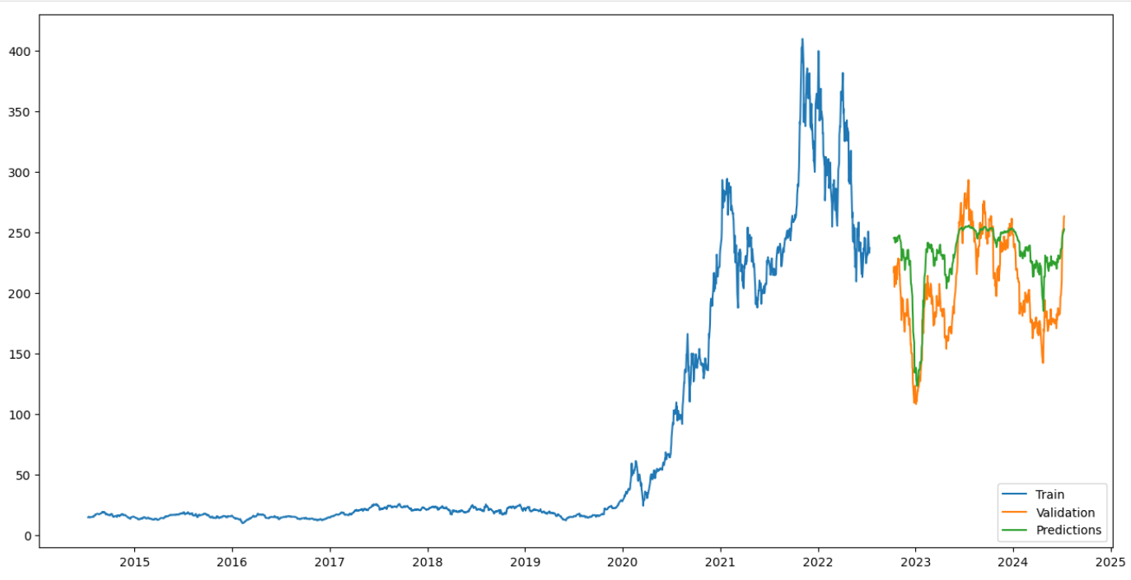
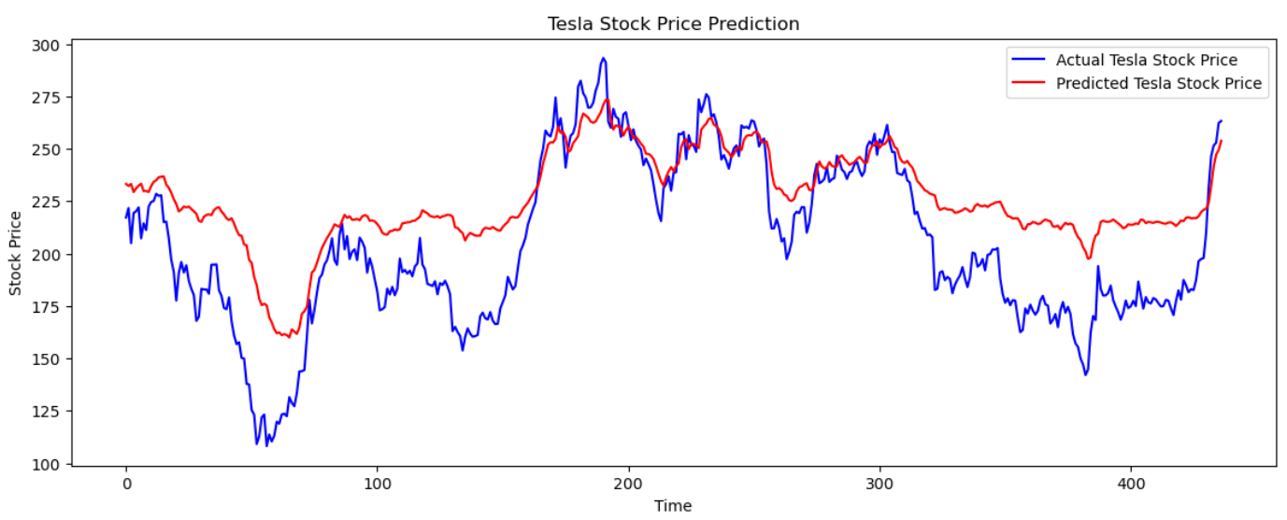
LSTM Model
Made 2 LSTM [Long Short-Term Memory] models: With Dropout layer and Without Dropout layer
Kept Sequence Length as 63 (number of days market is open in a quarter).
MAPE achieved 22.79% without dropout layer.
Trying to predict.

Slide 7
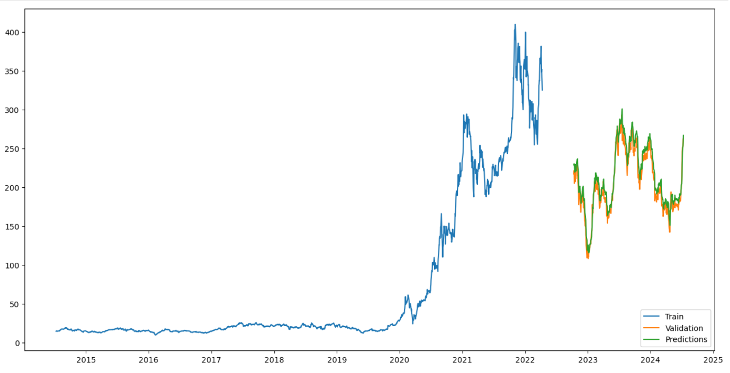
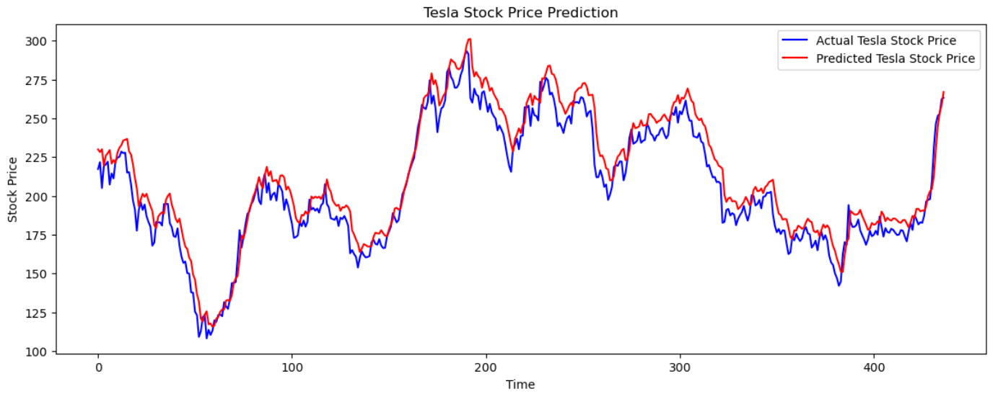
Gru model
GRU [Gated Recurrent Unit] is comparable to LSTM but faster and more compact, with potential limitations in handling long-term dependencies.
Maintained the same sequence length, incorporated dropout layers, and increased the number of epochs.
Achieved a MAPE of 4.78%. But all the results are Lagged.

Slide 8
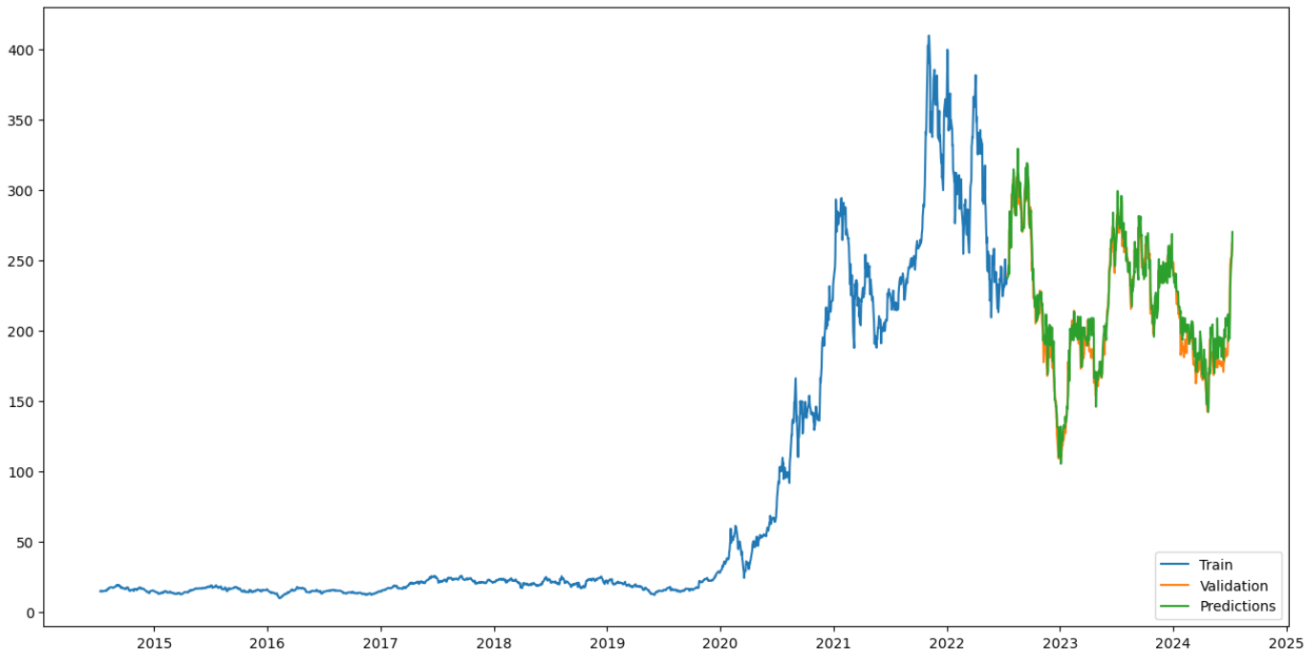
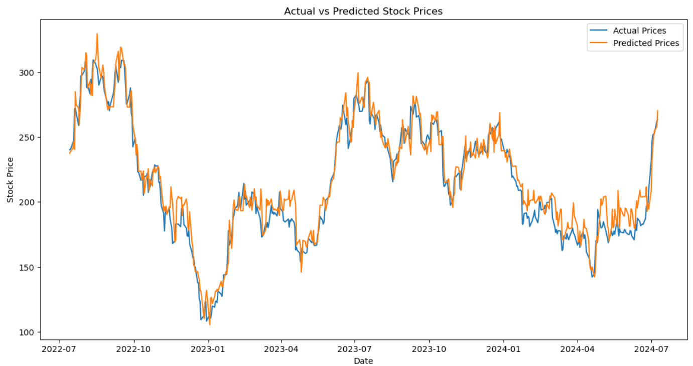
Random forest model
Non-sequential model, unlike LSTM and GRU, doesn’t rely on time dependencies but works well with non-linear data.
Got MAPE value as 4.53%.
Almost never gave accurate prediction, and usually predicts towards extreme values.

Slide 9

Sentiment Analysis model
Utilized DistilRoBERTa, a lightweight version of BERT, fine-tuned specifically on financial news data.
Accessed the model through HuggingFace, a widely-used open-source platform.
Performed sentiment analysis on 30,000+ financial articles using Google Colab's GPU resources.
Refined the model's output and exported results into a CSV file for seamless integration with a hybrid model.

Slide 10
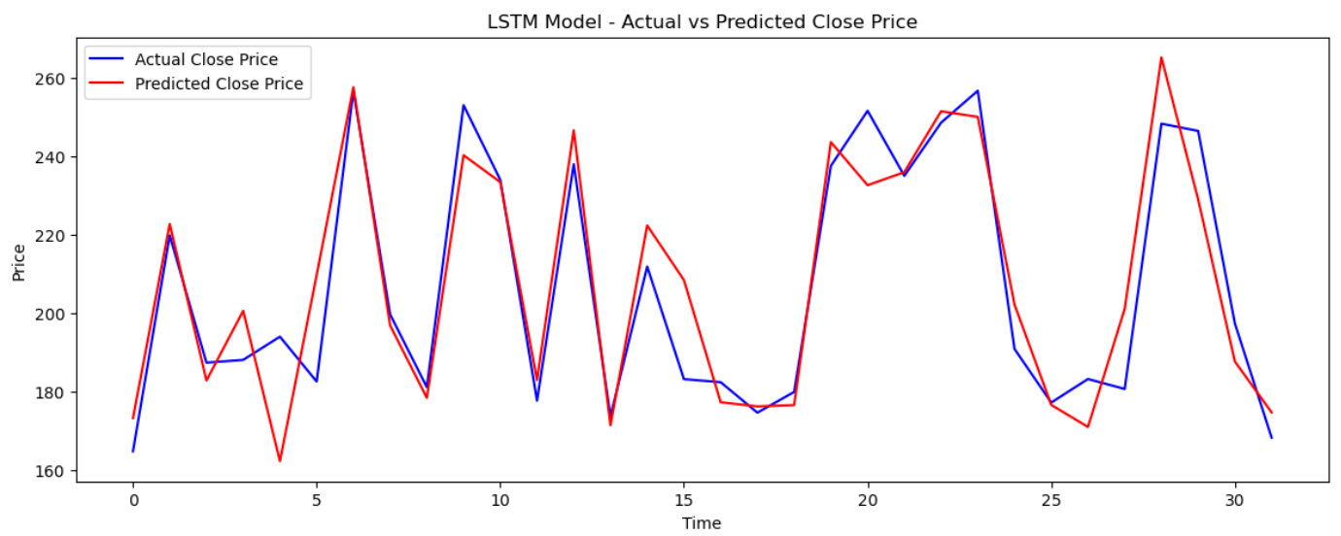
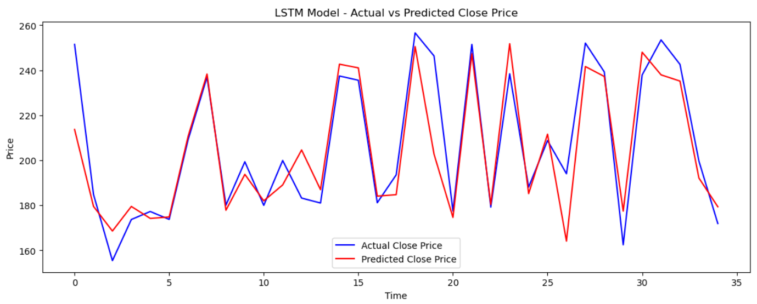
Hybrid model with LSTM
After careful considerations, LSTM is the best model for hybrid model building.
Applied LSTM on Closing values, Volume and sentiment scores.
Made 2 models of sequence lengths 5[number of days market is open in week] and 20[market is open in a month].
With sequence length 5 we got the best MAPE of 4.31%.

Slide 11

Model comparison
Models | MSE | MAE | MAPE
LSTM (No Dropout) | 854.60 | 24.05 | 22.79%
LSTM (With Dropout) | 1,231.81 | 30.30 | 25.13%
GRU | 130.72 | 9.49 | 4.78%
Random Forest | 134.94 | 9.04 | 4.53%
Hybrid LSTM (Seq 5) | 174.47 | 9.04 | 4.31%
Hybrid LSTM (Seq 20) | 152.66 | 9.47 | 4.71%

Slide 12

Conclusion
In conclusion, this dissertation has successfully demonstrated the effectiveness of developing a hybrid model for predicting stock market prices using sentiment analysis, despite encountering some operational challenges.
Challenges and future aspect:
News data collection posed a significant challenge throughout the project.
Anomalies remain one of the biggest hurdles in accurate stock price prediction.
Real-time predictions are the next step for future research beyond this project.

Slide 13
Thank you

